Slide 1

TATA GROUP
EST 2016
ZUDIO
EXPLORING MARKET DYNAMICS
GROUP 5
Ajay Mahendra Surve
Duc Anh Vu Bui
Jake Osness
Khushil Pankaj Patadia
Kush Popat
Maurya Sasanka Bhima
Sahil Walia
MKT 562
PROF. CHRISTIAN KIM

Slide 2

TABLE OF CONTENTS
3
4
5
6
7
8
9
10
11
12
13
14
15
16
17
18
Company Overview
Company History
Executive Summary
Market Overview & Competitive Landscape
Key Analysis Attributes
Data Collection Strategies
Respondent Overview
Principal Component Analysis (PCA)
Perceptual Data Analysis
Preference Data Analysis
Segmentation Analysis
SWOT Analysis
Strategic Recommendations
Action Plan
Key Challenges
Key Takeaways

Slide 3


EST. 2016
COMPANY OVERVIEW
Zudio, a fast-fashion retailer known for its affordable yet trendy apparel, has rapidly grown in India’s tier 2 and tier 3 cities.
In recent years (post 2020) , Zudio has expanded rapidly, with over 668 stores* in 274 cities across India as of February 2025. The brand has been able to effectively compete in the market with local and global brands in the value retail segment.
(*Official Zudio Store Locator data)
PAGE 3
Notes:
Founded by Trent Ltd (Tata Group)
- Key Positioning in India:
1. Affordable, trendy, and accessible fashion.
2. Expanding store presence rapidly.
3. Current Market Presence: Over 660+ stores in India.

Slide 4

OUR HISTORY
2016-2020
2021-Now
ESTABLISHMENT AND EARLY EXPANSION
EXPONENTIAL GROWTH & JOURNEY AHEAD
Launched in 2016, Zudio aimed to provide affordable, trendy apparel across India. The first independent Zudio store opened in the fiscal year 2018 (FY18), marking the brand's initial foray into standalone retail.
The brand's revenue surged to ₹32.6 billion (approximately $391 million), accounting for 42% of Trent's total revenue in in FY 2023-24
PAGE 4
Notes:
Tata Group of Companies own many globally known brands such as Jaguar - Land Rover, West Side..
Projections indicate that Zudio's revenue will reach ₹64.8 billion (approximately $777 million), comprising 56% of Trent's overall revenue by end of FY 2024-25

Slide 5


Unlocking Zudio’s Potential in the US Fashion Market
Objective:
Assess Zudio's market positioning relative to key competitors and develop strategic recommendations for U.S. market entry.
Key Insights:
Zudio has strong affordability and trend-focused fast fashion positioning in India. Competitive landscape analysis highlights potential positioning gaps and opportunities. Strategic recommendations focus on differentiation, pricing, and expansion.
PAGE 5
Notes:
- Why U.S. Expansion?
1. Growth potential in value-based fast fashion.
2. Gaps in competitor offerings for affordable yet trendy fashion.

Slide 6

MARKET OVERVIEW
COMPETITIVE LANDSCAPE
U.S Fashion & Market Landscape
Key Competitors & Their Strengths:
Zara – Premium fast fashion, strong brand image.
TJ Maxx – Discount-based value fashion.
Ross – Off-price retail with variety.
H&M – Sustainability and affordability balance.
Forever 21 – Trendy but struggling with branding.
Consumer preference shift towards affordability, sustainability, and accessibility.
Dominated by Zara, TJ Maxx, Ross, H&M, and Forever 21.
Market Trends
Where Zudio Fits?
Resale & budget-conscious shopping growing.
Digital transformation in fashion retail.
Increasing demand for fast-changing fashion cycles.
Affordable, trendy, fast fashion with a strong physical retail presence (in the current model)
PAGE 6

Slide 7

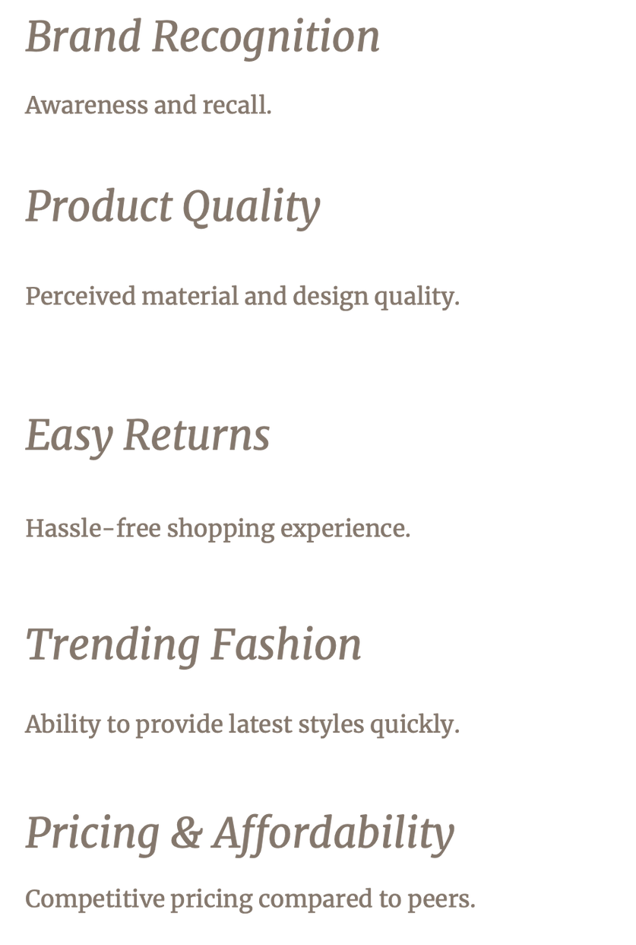
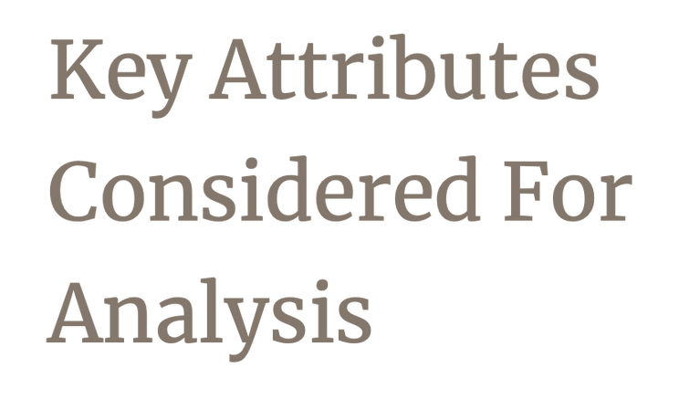
PAGE 7

Slide 8


DATA COLLECTION METHODOLOGY
Survey Sample
We used Google Forms to collect quantitative and qualitative data in a structured and quantifiable manner.
Data Encoding
GENDER
MALE: 0
FEMALE: 1
PURCHASE FREQUENCY
WEEKLY: 0
MONTHLY: 1
QUARTERLY: 2
RARELY: 3
CHANNEL PREFERENCE
ONLINE 1
OFFLINE (IN-STORE) 2
BOTH EQUALLY 3
AGE GROUP
<20 0
20-24 1
25-30 2
35+ 3
PAGE 8
Notes:
The data for this study was collected using a structured online survey via Google Forms. This method allowed us to reach a wide audience efficiently while ensuring structured and quantifiable responses. The survey targeted U.S. consumers interested in fast fashion, helping us capture insights into brand perception, shopping habits, and spending behavior.
To ensure comprehensive data collection, we employed a mix of multiple-choice questions, ranking scales, and optional open-ended responses. This approach provided both quantitative insights and qualitative perspectives on consumer decision-making.
Our strategy ensured process efficiency, anonymity for unbiased responses, and scalability, making it an effective tool for gathering consumer insights in the fast fashion industry.

Slide 9

RESPONDENT PROFILE
Surveyed 31 Students
Consumer Demographics: Most respondents ranged between 20-30 Years, with ~ 60-40 split for Male/Female.
(Sample Question from survey)
Perceptual Data: How consumers perceive Zudio vs. competitors on key attributes.
(Sample Question from survey)
Preference Data: Which brands consumers prefer to shop from.
(Sample Question from survey)
PAGE 9
Notes:
We Surveyed in total 31 students, and the data collected had questions based on ----
Consumer demographics:-
Insights on age groups, shopping habits, and brand familiarity to understand our potential target group.
Perceptual data:-
1. how consumers perceive Zudio vs. competitors based on key attributes like affordability, style, and brand image.
2. Helped us evaluate market positioning and identify gaps in the US fashion retail landscape where Zudio can stand out.
Preference Data:
1. We asked respondents about their preferred shopping destinations, both online and offline.
2. This data informs our decisions on store locations, marketing strategies, and pricing models.------

Slide 10
PRINCIPAL COMPONENT ANALYSIS (PCA)
Dimension | Variance explained | Cumulative variance
Dimension 1 | 83.7% | 83.7%
Dimension 2 | 15.5% | 99.2%
Dimension 3 | 0.6% | 99.8%
Dimension 4 | 0.2% | 99.9%
Dimension 5 | 0.1% | 100.0%
Dimension 1 (83.7% Variance Explained) – Reflects the overall brand strength as perceived by consumers, combining Brand Recognition, Trending Fashion, and Product Quality.
Dimension 2 (15.5% Variance Explained) – Represents the trade-off between Product Quality and Price/Value (Ticket Size).
Zudio's Position: Positioned far from competitors, showing a gap in consumer awareness.
PAGE 10

Slide 11
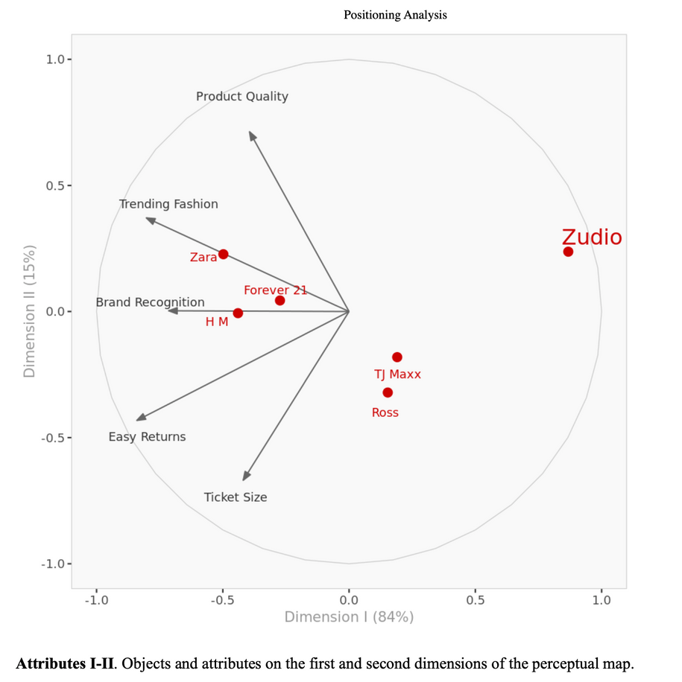
PERCEPTUAL DATA ANALYSIS
FINDINGS
Zudio scores lower in Brand Recognition but ranks better in Affordability.
Zara & H&M lead in Trending Fashion & Product Quality.
TJ Maxx & Ross dominate in Easy Returns & Price Sensitivity.
PAGE 11
Notes:
Explain Order-
1. Graph
2. Findings
3. Notes
- Dimension 1 Interpretation: Brands with higher values on these attributes (like Zara and H&M) are positioned positively, while those with lower values (like Zudio) are positioned negatively.
- Dimension 2 Interpretation: Brands with higher Product Quality scores (Zara, H&M, Forever 21) are positioned positively, while those with lower Product Quality or larger Ticket Sizes (Ross, TJ Maxx, Zudio) are positioned negatively
- Strategic Opportunities:
Leverage affordability and store presence as core strengths.
Enhance product quality and trend relevance to narrow the gap with premium competitors.
Continue expanding geographically to solidify market share.

Slide 12
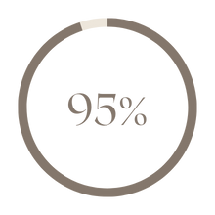
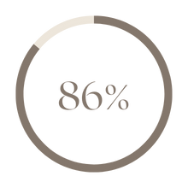
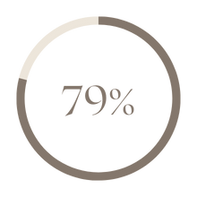
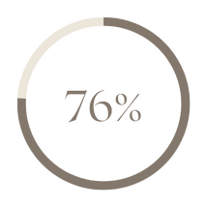
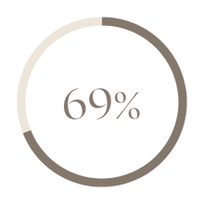
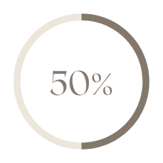
PREFERENCE DATA ANALYSIS
Brands | Average Preference | Segment 1 | Segment 2 | Segment 3
Zara | 4.74 | 4.81 | 4.92 | 3.67
TJ Max | 4.29 | 4.81 | 4.08 | 2.33
Ross | 3.94 | 4.81 | 3.17 | 3.67
H&M | 3.77 | 4.13 | 3.25 | 4.00
Forever 21 | 3.42 | 3.25 | 3.58 | 3.67
Zudio | 2.48 | 2.06 | 2.92 | 3.00
TJ MAXX
H&M
FOREVER 21
ZARA
ROSS
ZUDIO
SEGMENT 1 (45%) – PREMIUM BRAND SHOPPERS
SEGMENT 2 (35%) – BUDGET-CONSCIOUS SHOPPERS
SEGMENT 3 (19%) – TREND-FOCUSED BUT PRICE-SENSITIVE
PAGE 12
Notes:
Segment 1 (45%) – Premium Brand Shoppers
1. Prefer higher-end fast fashion brands such as Zara and H&M.
2. Likely value brand prestige, perceived quality, and trendy designs.
3. Less sensitive to price.
Segment 2 (35%) – Budget-Conscious Shoppers
1. Prefer discount retailers such as TJ Maxx and Ross.
2. Likely prioritize affordability and deals over brand prestige.
3. More focused on getting value for their money.
Segment 3 (19%) – Trend-Focused but Price-Sensitive
1. This group is interested in trendy fashion but still values affordability.
2. Likely considers Zudio and Forever 21 as shopping destinations.
- Key Takeaways from the Segmentation
1. Segment 3 is the most relevant target audience for Zudio in the U.S.
2. Zudio is not yet strongly recognized compared to competitors.

Slide 13
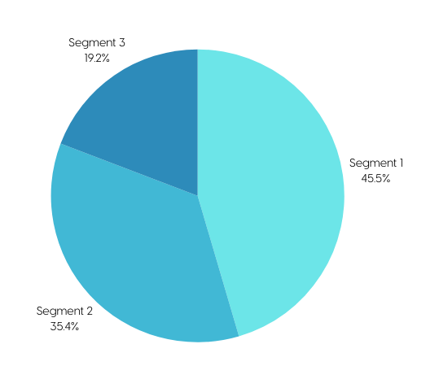
SEGMENTATION ANALYSIS
CONDUCTED K-MEANS CLUSTERING TO IDENTIFY 3 CONSUMER SEGMENTS
Dimension | Dimension I | Dimension II | Dimension III
Segment 1 | -0.507 | -0.394 | 0.256
Segment 2 | -0.021 | -0.213 | 0.372
Segment 3 | -0.007 | -0.017 | 0.644
Segment 1 (45%) – Prefers premium brands (Zara, H&M).
Segment 2 (35%) – Budget-conscious shoppers (TJ Maxx, Ross).
Segment 3 (19%) – Trend-focused but price-sensitive (Zudio & Forever 21 potential shoppers).
PAGE 13
Notes:
Target Segment:
Segment 3 → Zudio can potentially target the audience Interested in trendy fashion at affordable pricing.

Slide 14
STRENGTHS
Competitive pricing, emerging presence, affordability.
WEAKNESSES
SWOT ANALYSIS
Low brand recognition in the U.S., perception of mass-market brand
OPPORTUNITIES
Cater to the market by filling the existing gaps.
THREATS
Cater to the market by filling the existing gaps.
PAGE 14
Notes:
Add more speaker notes
Talk about SWOT analysis in brief
Move to slides

Slide 15
STRATEGIC RECOMMENDATIONS
PAGE 15
STRENGTHEN BRAND IMAGE
EXPAND EFFECTIVELY
in the U.S.
LEVERAGE COMPETITIVE PRICING
Invest in influencer marketing & digital advertising.
Research for creating unique in-store experiences.
Target key metro areas (e.g., New York, Los Angeles, Miami).
Start with pop-up stores & Brand collaborations before full fledged expansion.
Offer affordable, stylish collections targeting Gen Z & budget-conscious millennials.
Limited-time promotions & loyalty programs.
PAGE 6
Notes:
Influencer Marketing- How to leverage effectively
Loyalty programs- how to make them effective for Zudio
1
One of Zudios biggest problems is brand recognition in the US. To compete we need to invest in digital advertising, influencer marketing and social media campaigns.
Store promotion events with influencers, or exclusive clothing lines.
2
Expansion to US in phases, start with pilot stores in key metro areas
Utilize social media marketing as well as promotional events
leverage ecommerce via influencer marketing
3
Affordability is what Zudio is known for, sustaining a low price is important to create a brand image. They need to offer affordable clothing to the budget conscious group.
Can use loyalty programs such as offering discounts after a number of visits or in store points that you can use as cash on store items.
Should be priced below zara and h&m but not Ross or TJ maxx.

Slide 16
ACTION PLAN
PAGE 16
SHORT TERM
(6-12 Months)
LONG TERM
(1-3 Years)
Launch pilot stores in major U.S. cities.
Implement aggressive digital marketing campaigns.
Maintain affordable pricing to sustain budget-conscious customers
Consumer Research to get a deeper understanding of the market
Focus on testing market and creating a brand image
Expand physical retail stores if the initial stores are successful.
Establish a U.S.-based logistics network for smooth operations.
Focus on customer retention by utilizing loyalty programs or clothing lines tailored to the US.
PAGE 6
Notes:
With Regards to Zudios expansion into the us we developed an action plan that covers the steps we suggest that zudio take in order to enter the us market successfully.
Short Term: Testing the market and creating a brand image
Launch pilot stores in key cities such as Miami,Los Angeles, Seattle, New York. These markets are diverse and would fit the target audience of zudio.
Digital Marketing Campaign in the form of social media advertising, influencer sponsorships, promotional events or posts.
Perform In depth consumer research to understand how to succeed in the market effectively.
Long Term: Target more cities with a similar type of consumer base if the initial stores are successful. Logistics network should be leveraged to reduce costs, and streamline supply chain processes. Additionally a key aspect is to focus on customer retention, via loyalty programs, discounts, as well as clothing lines designed for the us specifically.
These steps should ensure that Zudios expansion into the us is successful however there can be some hurdles we will now look into the key challenges

Slide 17

KEY CHALLENGES
U.S. market is highly competitive, requiring significant investment to gain traction.
Zudio is highly successful in India but is not well known by many americans.
Cultural differences between Indian and U.S. markets may affect Zudio’s growth in the U.S markets.
Need to conduct extensive market research before starting operations
PAGE 17
Notes:
Expanding into the us provides a lot of opportunity, but has many problems that it must address in order to succeed.
Highly competitive market, with Ross, TJ Maxx, Zara, H&M dominating. These brands all have a strong brand image and a significant customer base. Zudio needs to be able to differentiate themselves to generate some growth.
Zudio is very successful in india but is not known by almost anyone in the us. They will need to invest heavily in marketing, especially digital marketing to cultivate brand recognition.
This can be mediated by sponsoring influencers who align with your target audience to get your brand advertised to a vast number of american viewers who already have an interest in your product.
Trends in india may not be the same in the us, new collections may need to be developed, this could be achieved through Exclusive collections to draw in consumers. similarly pricing and shopping habits can be different and need to be investigated and tested. ie Sustainability on the rise in the us, affecting price. Zudio needs to be adaptable and change to fit the needs of the new style of customer.
The final hurdle is that this will cost a large amount of money to fund, breaking into a new market overseas is a large task and requires an enormous investment to setup all facets of the organization. It will be very important to keep profits high in the early years.

Slide 18
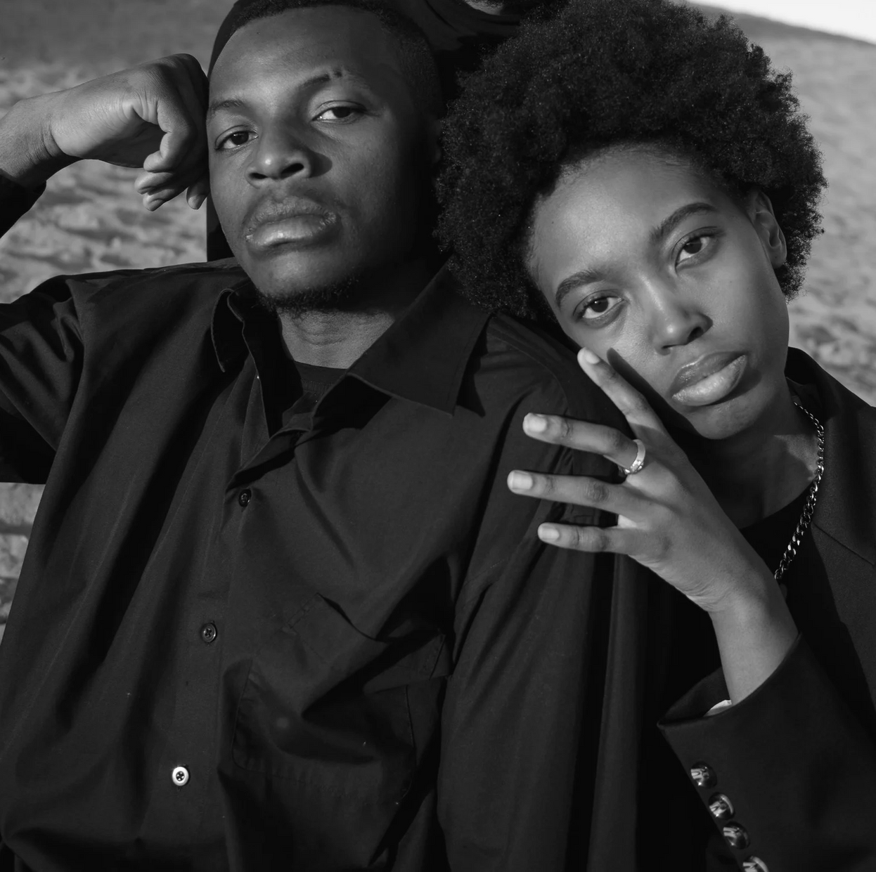

KEY TAKEAWAYS
Zudio has a strong opportunity in the U.S. but must overcome low brand awareness.
Positioning should focus on trendy fashion at affordable pricing.
Expansion strategy should leverage digital-first marketing and urban store locations.
Competitive threats exist, but Zudio can differentiate by targeting price-sensitive trendsetters.
FAST FASHION
PAGE 18
Notes:
Digital marketing, influencer sponsorships, and other strategic branding efforts will be absolutely essential to success.
The market is very saturated but if Zudio can focus on catering to the price-sensitive but also trend conscious, like Gen Z or budget-friendly millennials.
Online promotions and influencer posts can help get a feel for the demand before launching into the market fully.
There is risk in expanding into a new market, but with that risk there is also the potential for success if we can successfully leverage our strengths to overcome the key challenges we discussed. Utilizing digital marketing will be essential, creating a strong brand image via fun and interesting store experiences, and by selecting the cities strategically .
Overall zudio will face many challenges but by using a well structured strategy we can be positioned well to succeed.

Slide 19

THANK YOU

